Slide 1
Chapter- Nine- Reporting Technical Information

Slide 2
Reporting technical information
A report is a document reporting the status of an activity or project as it occurred, or after some action has been taken, or when they are concluded.
Reports are written by specialists/researchers to special/specialist audiences.
They include detailed information on a topic, or issues.
Typically, they include findings from research.
They may be useful for senior managers to make decisions.
Eg : annual reports, monthly reports, audit report, project report, feasibility reports/ laboratory report etc.
A proposal is a detail plan made for carrying out a task.

Slide 3
Stages in Writing Report
Clarifying Your Terms of Reference: Define the purpose, scope, audience and key questions of the report.
Planning Your Work: Outline steps, set timelines, allocate resources and decide the report's structure.
Collecting Your Information: Gather credible data using suitable methods and ensure it aligns with the report's purpose.
Organizing and Structuring Your Information: Arrange information logically and use headings and subheadings for clarity.
Writing the First Draft: Focus on content over perfection and follow the planned structure while drafting.
Checking and Re-Drafting: Review for accuracy, coherence and clarity, then refine and edit based on feedback.

Slide 4
Types of technical reports
The status or progress report
The information report or white paper
The laboratory report
The recommendation report

Slide 5
1. Status or progress reports
Status reports are also known as progress or activity reports
Status or progress reports generally focus on the progress of a particular project.
Progress reports are generally used as a way for employees to update supervisors on how they have spent their workweek, noting accomplishments on various assigned tasks or alerting managers to potential or real problems that may be awaiting.

Slide 6
Purpose of Status Report
To update team members and managers on the progress and status of projects within an organization,
To show an organization’s /individual’s competence in pursuing and completing a task.
To help in conducting the work, assessing it and plan for future work

Slide 7
Content of status report
It summarizes what has been accomplished.
It supplies information about any problems.
It describes the actions taken to resolve problems.
It outlines the writer’s plans for coming weeks.

Slide 8
Format
Introduction
Work Completed
Work yet to Complete
Overall Assessment of Progress

Slide 9
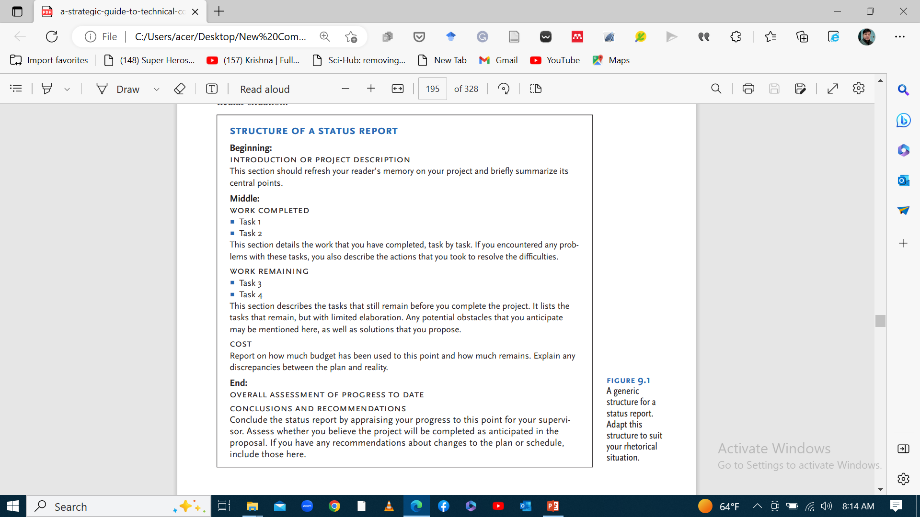

Slide 10
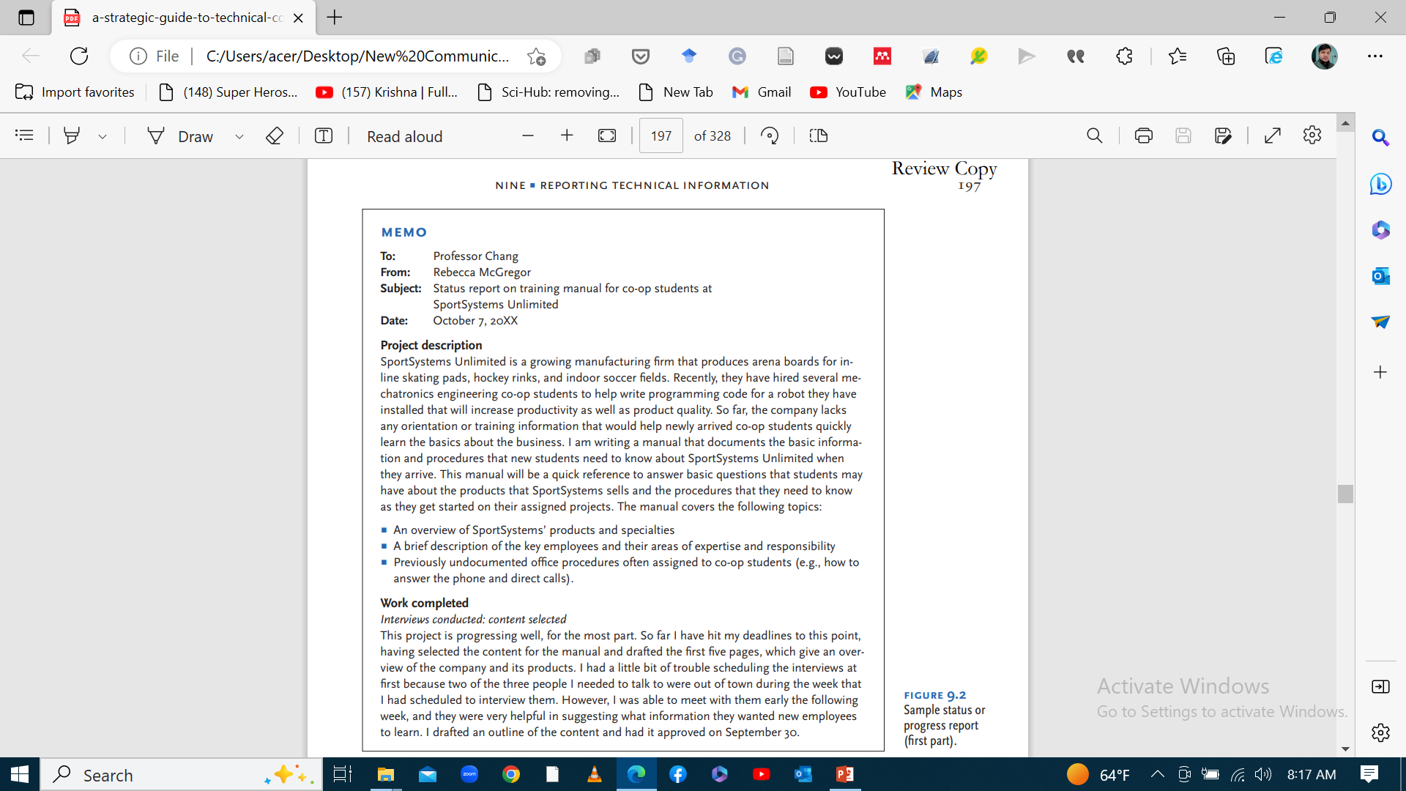

Slide 11
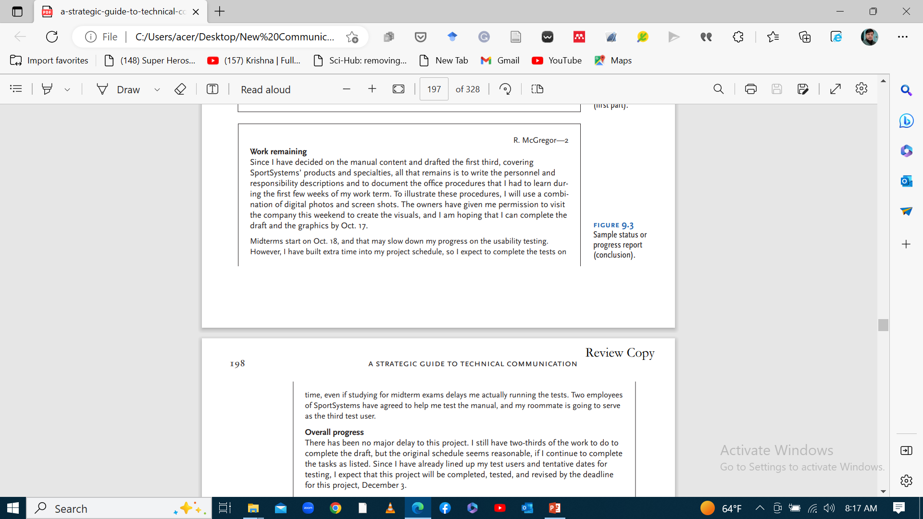

Slide 12
2. White papers or information reports
White papers (information reports) are reports that provide information about a particular topic.
They argue a specific position on the issue or provide a solution to a problem by introducing innovative technology or new products.
In technical fields, especially in the IT industry, white papers are both technical documents and marketing documents.
From the company’s perspective, their purpose is generally threefold:
To inform readers
To educate them about the advantages of a new product or service.
To persuade them that this innovation is the superior solution to a particular problem

Slide 13
What are some useful strategies that will increase the effectiveness of your white paper?
Summarize the key points that newcomers need to know to appreciate the new product or service.
Assume your reader is a newcomer to the subject.
Describe the problem in specific and personalized terms.
In describing how your product or service works, distinguish its dominant features which benefits the readers/users.

Slide 14
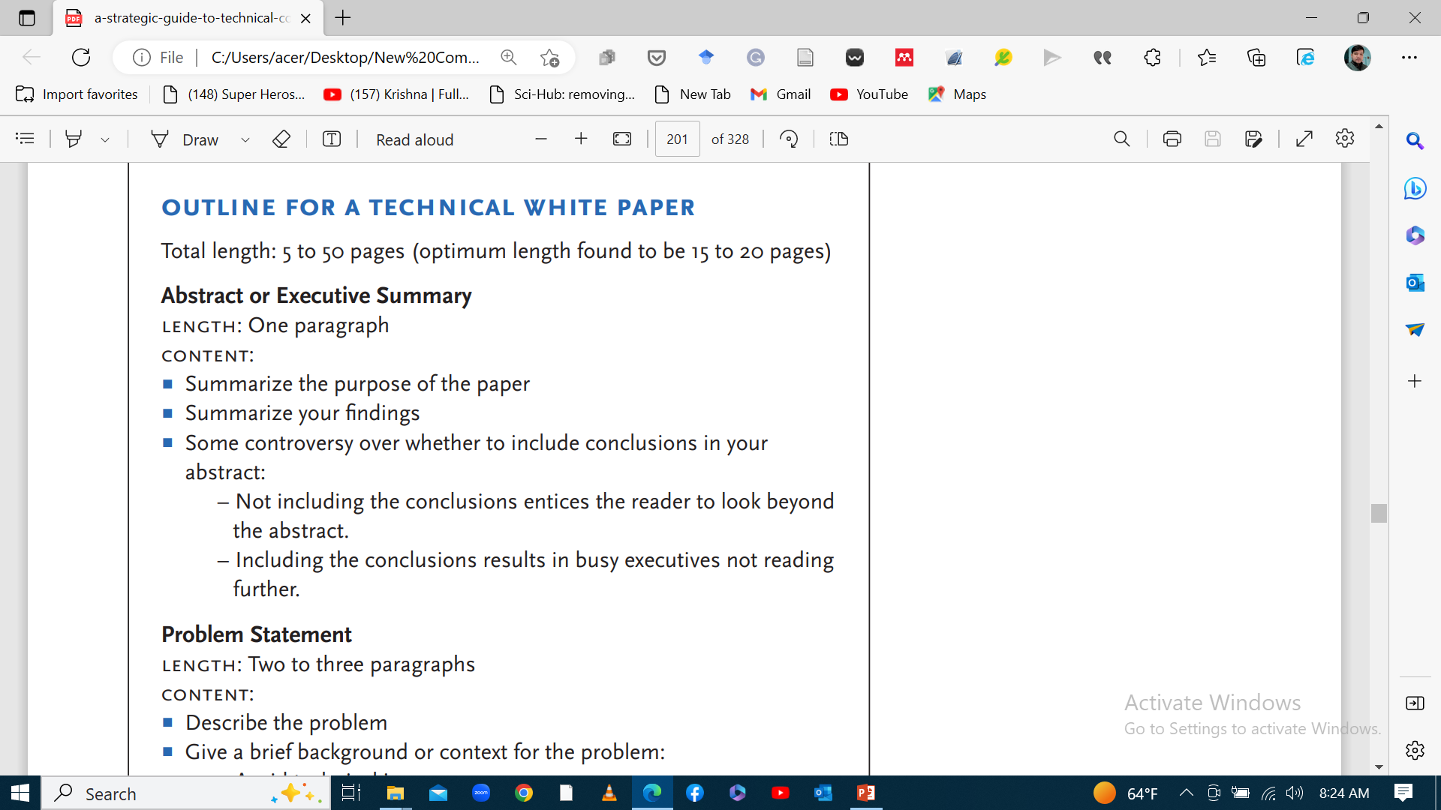

Slide 15
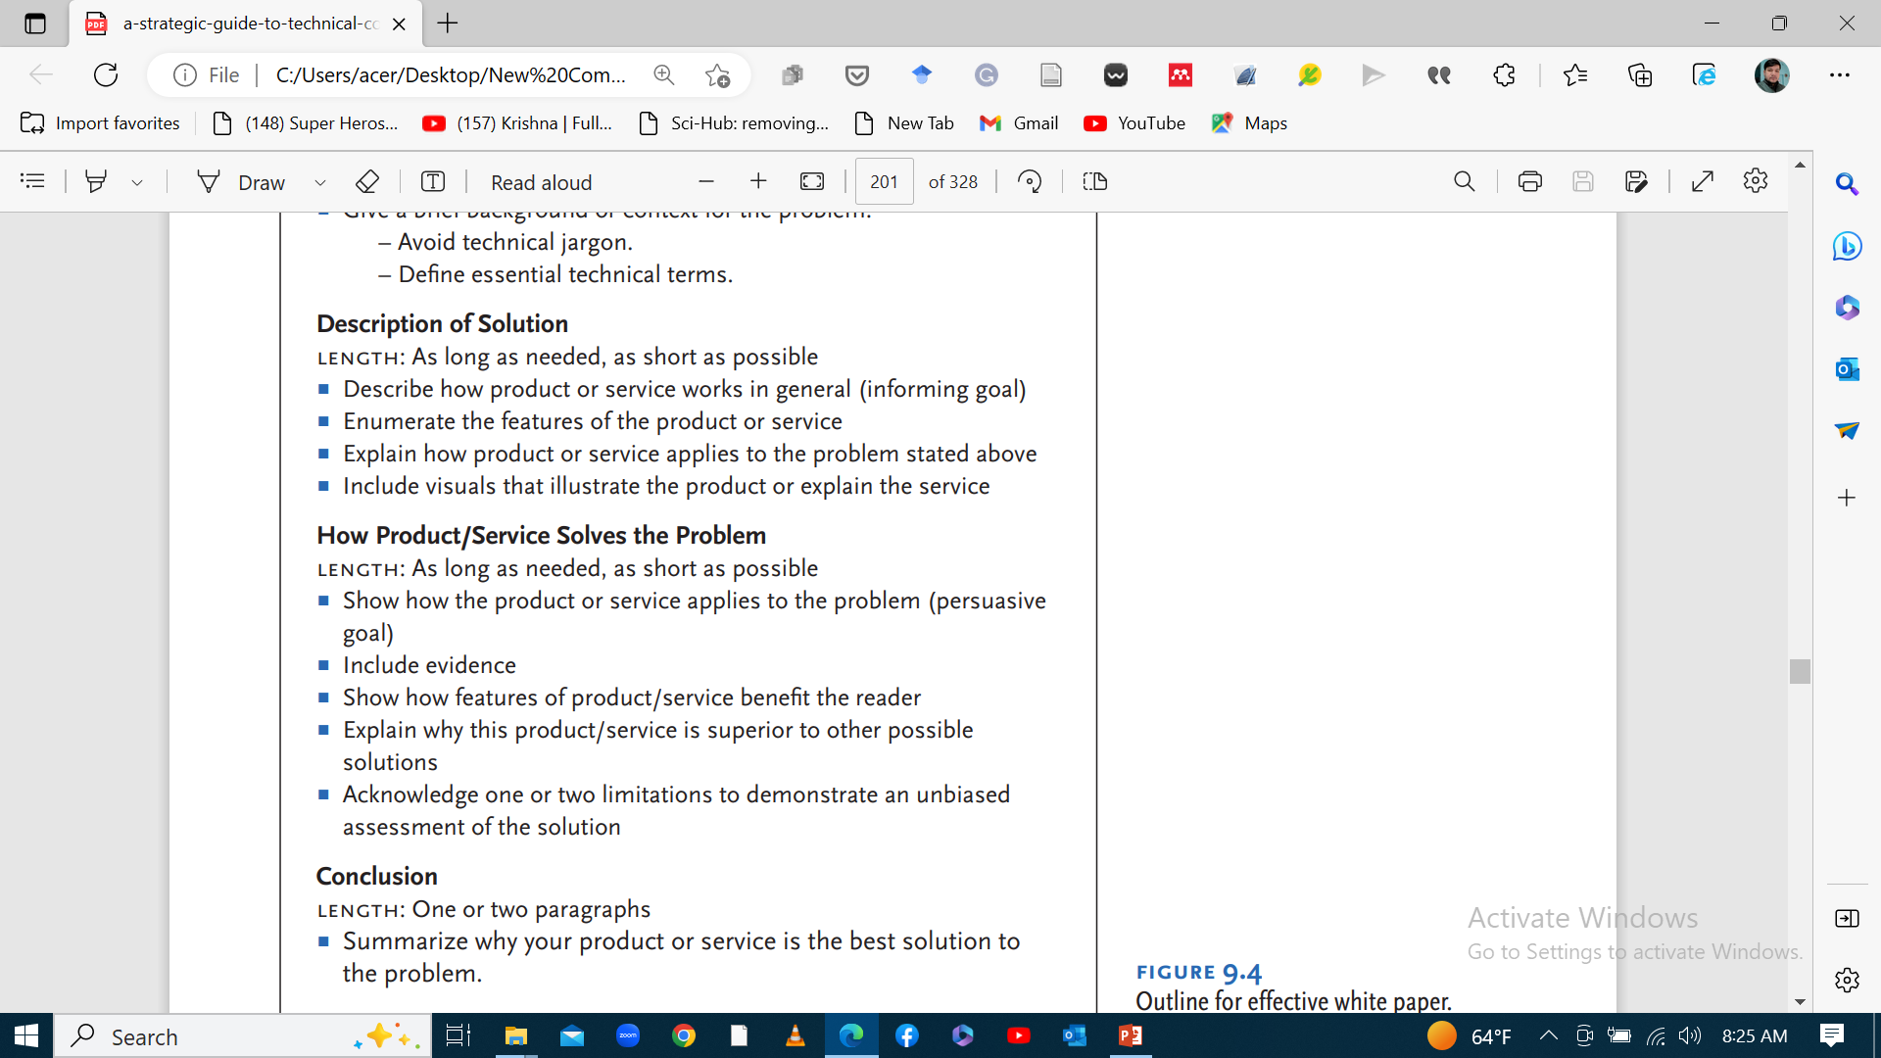

Slide 16
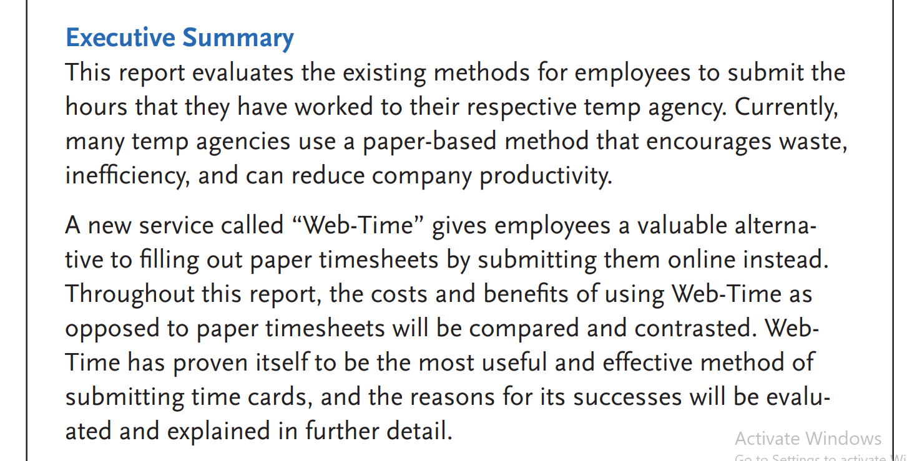
Example

Slide 17
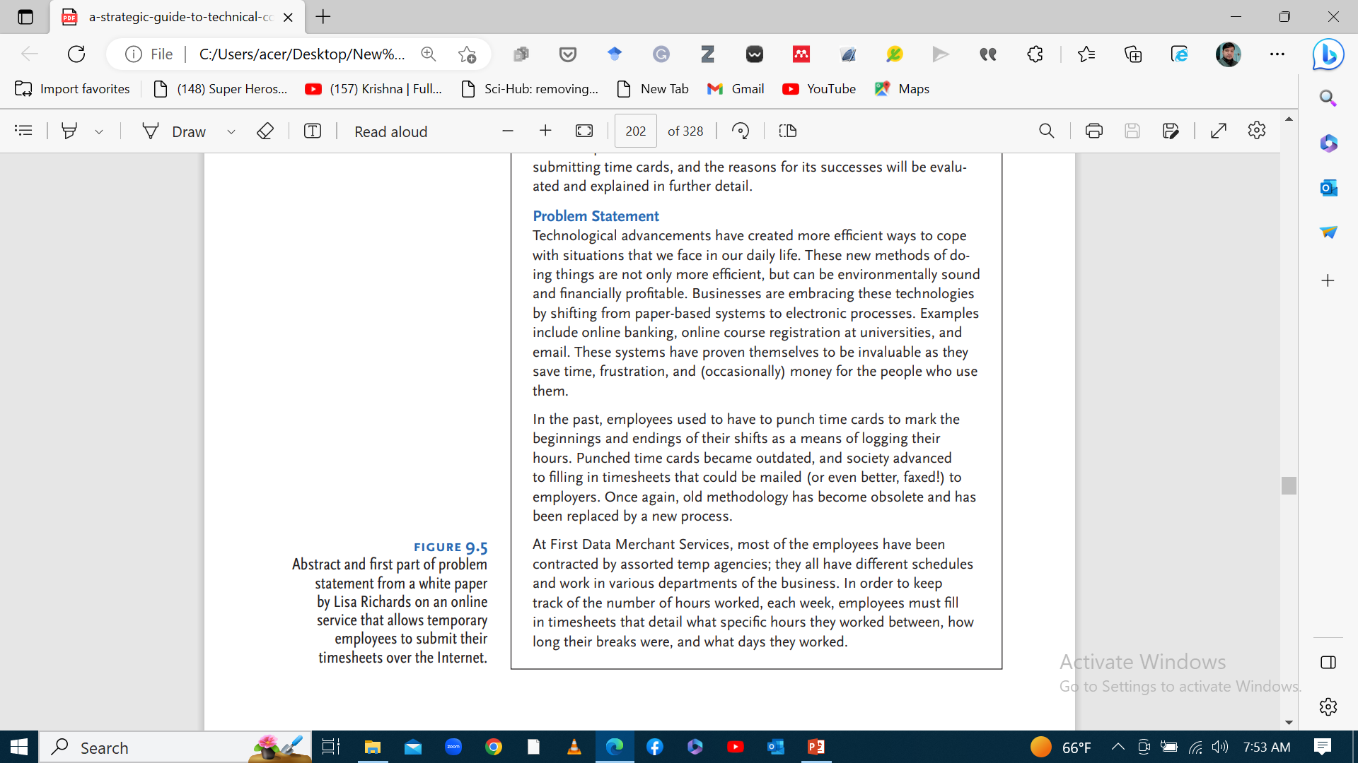

Slide 18
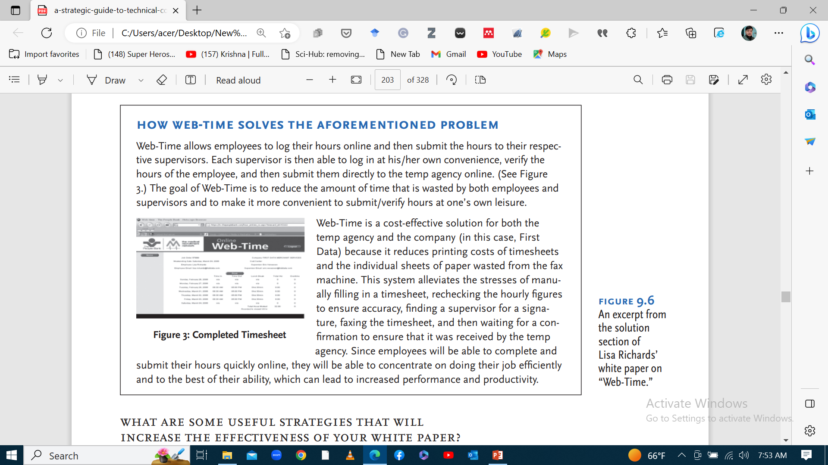

Slide 19
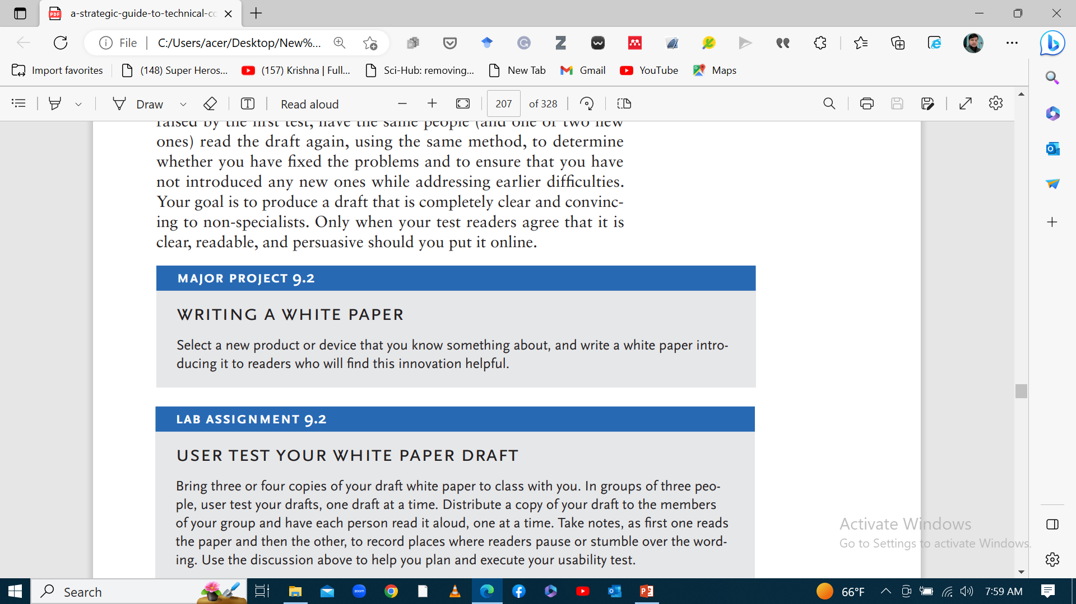

Slide 20
3. The Laboratory Report
Each field that uses the laboratory report has its own specific requirements about how to write one well.
The initial step that directly affects report quality is how well you record your experiment in the laboratory notebook while doing the experiment.
A laboratory report helps students practice experiments, use equipment, perform lab activities and present results in written form.
lab reports for school focus on creating new knowledge for the student rather than demonstrating a gap in existing knowledge.

Slide 21
The Laboratory Notebook
Experimental descriptions in the laboratory notebook.
Laboratory reports rely on experimental evidence documented in a notebook, making their quality dependent on the accuracy of those records.
The notebook is critical for scientific integrity and accuracy should be maintained.
Accurate and truthful records are crucial evidence in legal disputes over intellectual property and patent issues.
While you are conducting the experiment, you should be recording clear and detailed notes about the following:
Your actions
Your observations
Your thoughts

Slide 22
Your laboratory notebook should have the following qualities
It should be a bound/certain volume.
Experts recommend that you use a bound notebook.
Don’t use a loose-leaf binder for your notebook because the pages can fall out easily or be moved out of sequence.
Don’t use a spiral notebook because pages can be removed without it being noticeable.
-All of the pages should be numbered and dated in sequence.
-All entries should be in waterproof, non-erasable ink.
-Don’t leave blank pages.

Slide 23
Format
Title (and author[s])
Introduction
Procedure and materials
Results
Discussion
References

Slide 24
The effects of temperature and pH on encouraging and deterring the growth of bacteria vs. fungus
Introduction
This experiment was done to determine the optimal temperature and pH conditions for different micro-organisms. These two environmental factors have the greatest impact on the growth of a micro-organism, which makes them both important and straightforward to study. It is important to know the optimal temperature and pH for the growth of different bacteria and fungi because they both affect our food and our health. In this experiment, the amount of growth of micro-organisms was determined using a spectrophotometer as well as visually. Using both methods also highlights the strengths and weaknesses of both techniques.
For the determination of optimum temperature, four bacteria and two fungi were used, and for the determination of optimum pH, three bacteria and one fungus were used. The bacteria used grow at different optimal temperatures, but were all capable of growing well on the same nutrient agar plates or nutrient broth solutions. Similarly, the fungi used in the temperature determination were both grown on Sabouraud’s agar. Every micro-organism that was used for this experiment can be found in some type of food, either as an aid to processing it or as spoilage.
Temperature is the most influential environmental condition that affects cell growth and survival (Madigan et al., 2003). At the optimum temperature for a specific micro-organism, its biochemical reactions run quickly, allowing the cell to grow at its maximum rate. This is the optimal growth range for temperature for a specific organism. If the temperature is increased too far past this point, the maximum temperature of the organism is reached. This is the temperature at which the micro-organism’s enzymes begin to be denatured by the heat, prohibiting the growth of the cell. The minimum temperature is the lowest temperature at which the organism can grow. Below this temperature, the reactions within the cell occur too slowly, and the cell membrane begins to gel, prohibiting growth (Madigan et al., 2003). The optimal growth range of temperatures that micro-organisms grow best at can be anywhere from below 0oC to above 100oC (Madigan et al., 2003). Increasing or decreasing the temperature of an organism’s environment to within the micro-organism’s optimal temperature range encourages growth. Conversely, if the environmental temperature is moved not only out of the optimal range for the organism but also past the maximum or minimum temperature, the micro-organism can no longer survive. The closer that the environmental temperature gets to the maximum or minimum for a specific organism, the more growth is deterred.

Slide 25
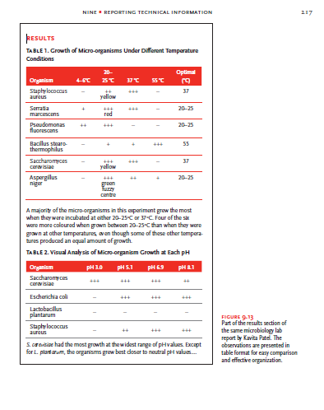

Slide 26
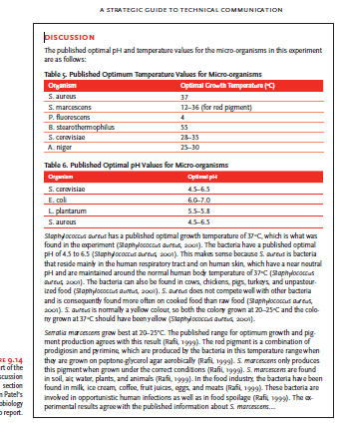

Slide 27
4. Recommendation Reports
In a recommendation report, the technical communicator (or engineer) describes the problem and then presents several possible solutions that he/she has formulated based on extensive research.
Among several solutions of the problem, the report recommends one solution over others, explaining what makes it superior.
A variation on the recommendation report is the feasibility report, which discusses the possibility of applying one recommended solution to a problem.

Slide 28
Format
Memo or letter of transmittal
Title page
Executive summary or abstract
Recommendations
Report body (introduction, scope, methods, results, discussion)
Conclusions
Notes, references, appendixes

Slide 29
ValuSpec Home Inspection Servi ce
North America’s Number One Home Inspector
July 5, 20XX
Dear Client:
Re. Home Inspection
947 Woodbury Dr., Winnipeg, MB.
ValuSpec Home Inspection Service has completed a visual inspection of the property and building at the address above. Thank you for choosing ValuSpec, and we appreciate the chance to work with you at this time. The enclosed report provides you with extensive information about the general condition of this property after a visual examination of the accessible areas of the house, based on the enclosed Inspection Agreement. Please note that no aspect of the home was dismantled, so the inspection judgments are based only on the evidence visible without further probing.
We found three major areas of the home and property that you would want to address within a year or two of purchasing this property. There are a number of minor issues, and they are detailed in the report. We recommend that you complete the following at your earliest convenience:

Slide 30
Replace the roof.
2. Improve ventilation in interior to reduce overall humidity levels.
3. Improve drainage around base of foundation at southeast and northeast corners of the house.
The inspection began at 9 a.m. and concluded at 11:30 a.m. on June 27, 20XX. The current owners of the property were in residence at the time, so our inspection was limited to a visual examination with little moving of personal effects.
I would like to thank Robert Stafford, P. Eng., who allowed me to accompany him during the inspection as part of my responsibilities as a student worker at ValuSpec. He also reviewed a draft of this report, and his comments were helpful in sharpening my analysis and clarifying my explanations, especially of obvious humidity problems on the premises.
Again, thank you for the opportunity to undertake this inspection. It has made a valuable contribution to my education as a civil engineer.
If you have questions or concerns after reading this report, please contact me at mtrottie@ engmail.uwinnipeg.mb or telephone me at 321-123-4567.
Sincerely,
Michel Trottier
Michel Trottier

Slide 31
Executive summary
Conclusions
Overall the dwelling and yard are in fair condition. There appear to be no major structural problems that would affect a potential purchaser’s decision to buy this property. That said, the house is eighteen years old, and some of its systems do show wear and tear equal to a residential property of this age.
Recommendations
We recommend that the client consider the following maintenance projects within the next two years:
1. Replace the roof. Currently, the roof consists of one layer of asphalt composite shingles.
Noted were worn, curling shingles; loose or missing gravel; and evidence of patching. We were unable to determine whether these repairs were effective. Based on these observations and information obtained from the current owner, the shingles are nearly 18 years old. The shingles currently in place average 15–20 years, and they show normal wear and tear for their age. The age of the roofing membrane appears to be reaching its useful life, so we recommend that the client plan to replace it in the near future.
2. Improve interior ventilation to reduce overall humidity levels. We noted a potential environmental issue with the presence of mould on interior portions of several windows in the home and basement. A more intrusive examination would be needed to determine the scope and nature of the mould growth. We recommend removing all sources of moisture: install or repair kitchen and bathroom exhaust fans; disconnect furnace humidifier, and use dehumidifier to remove excess moisture; seal the building envelope to prevent water entering from the outside. If mould persists after completing these actions, consult a qualified mould abatement contractor for additional evaluation and treatment options to ensure safe air quality indoors.

Slide 32
3. Improve grading around building foundation. We saw evidence of some leakage around the windows in the basement. Ground levels around the foundation also show some compression against the concrete where rainwater and other moisture could pool, presenting a potential leakage problem. We recommend redoing the grading by building up earth in compression areas. The earth against the house should slope away so that water will run away rather than pool around the foundation.
The report provides a detailed discussion of all of the major systems in the house and evaluates their condition, making suggestions where appropriate about solutions that the client should undertake to improve conditions. Minor problems to be aware of include several inoperable systems: electrostatic air cleaner on the furnace, garage door opener....

Slide 33
Introduction
This report provides information about the condition of the home and property at 947 Woodbury Dr. It was written in response to a request by Charles Fields for an inspection of the home in connection with the possible purchase of the property. He requested that we examine the systems within the house with the goal of identifying any that needed repair or replacement, with an emphasis on evaluating the potential seriousness and costliness of addressing any structural or system-related problems that were noted.
This report details the condition of the home as it was observed during the inspection on June 27, 20XX. As is routine in reports of this nature, we have summarized the overall condition of the house before detailing the specific condition of the various systems of the house. The discussion moves from the exterior of the building to the lower level and then to the main level.
The major systems demanding immediate attention are summarized in the Recommendations section of the report. More minor problems are noted during the general description of the survey results.
Please note that the following terms are used in the report:
S = serviceable, meaning the materials and workmanship associated with the part being inspected are acceptable, and it is in generally satisfactory condition.
N = not applicable, meaning the part does not exist or apply to the property.
Also note that the point of reference given to locate a particular component is the front exterior of the building, facing the main entrance (e.g., the sump pump is located in the lower level at the rear right side).

Slide 34
Limitations
Please remember that the personal effects of the current owner occasionally limited the scope of the inspection because the inspection team was unable to undertake extensive moving of these effects. However, we have noted in the report those instances when the belongings limited the examination.
Purpose
The purpose of this report is to evaluate the overall condition of the building and property at 947 Woodbury Dr. in Winnipeg, MB, and to assess the extent of any structural or system-related problems that will require repair or replacement.

Slide 35
Short Report (for Exam)
Title
Introduction
Objectives
Methods
Findings
Discussion
Conclusion and recommendation

Slide 36
Major Project 9.4
writing a recommendation report
Major Project 8.1 (option 2) in Chapter 8 asked you to write a proposal to create a recommendation report based on a topic of your choice. Create the report that you outlined in your proposal. Follow the development plan and work schedule described in your proposal to complete the report.
Many of the topics that are covered in this book will be important to consider as you write your report, including document design, adding visuals where appropriate to present statistical or technical data, organizing information, and making your writing clear for specific audiences.
Follow the format outlined in this chapter on how to structure a recommendation report.
Purpose and Audience
Before you begin, you should have a clear sense of whom your primary and secondary readers are for the report. Include the background information that they will need to understand your discussion, and tailor your arguments to match those that your readers will find convincing and compelling. Also make sure that you understand why you are writing this report and what main points you want to convey to your readers.
Use the outline below to structure your report, and draw on the rhetorical appeals discussed in Chapter 4, “Writing technical prose,” to develop and explain the solutions that you found for the problem that you identified and analysed:
Letter or memo of transmittal
Title page
Executive summary or abstract
Recommendations
Body of report (introduction, scope, methods, results, discussion)
Conclusions
Works cited or references
Appendices

Slide 37
THANK YOU

